Slide 1
How Technology simplifies
GST Compliance?
CA A.Rafeq, FCA, CISA, CGEIT, CIA

Slide 2
Learning Objectives
1. Using Technology for GST
2. Implementing GST using Technology
3. Avenues for CAs in IT-enabled compliances in GST
4. Practical Case Study and Scenarios

Slide 3
Presentation perspective
Business Process - Automation
Compliance - Implementation
GST – Advisory/Assurance

Slide 4
1. Using Technology for GST

Slide 5

Art and science of Simplicity

Slide 6
Digital Disruption
Earlier, Business Embedded Technology
Now, Technology Embeds Business processes, Compliances and Assurance
Technology is driving rapid transformation in diverse and dynamic ways
New Business models and information systems are rapidly implemented
Software-driven Information Systems are key differentiator for enterprises

Slide 7
Technology Transformation in India
Move to
Digital is inevitable,
Digital is future and
Digital is Now!
IT is accelerating
eCommerce,
mCommerce, eBanking, eWallet mBanking, DIGITISATION!
Technology push by Government to curb corruption & increase transparency, deliver services.
GST automation, digital payments, eGovernance, online filing, etc.

Slide 8

Why Technology is the key in GST
  GST is transaction based technology driven compliance
  B to B to G data exchange through GSTN
  Triangulation of Business records with GSTN

Slide 9
Technology FAQs of GST
How is GST implemented through Technology?
What is impact of GST on Application Software?
How can CAs leverage Technology to provide IT-enabled Compliance services?
How can CAs update & prepare for future?

Slide 10

What does this all mean?

Slide 11
2. Implementing GST using Technology

Slide 12
  Critical Components of GST
Components
Registration
Tax Credits
Returns
Taxability
Time of Supply
Valuation
Supply
Place of Supply

Slide 13
  Transition to GST→ Technology Transition
3. Carry forward of CE/ST/VAT credits
4. Stock lying with agents on transition- impacts
6. Existing registration- migration to GST
8. Impact on pending refund claims- filed/unfiled
9. Continuing contracts-
Revision, Spill over to GST
2. Review of present credits, compliance
1.Process re-engineering & training
7. Pending legal cases
5. Unfinished transactions

Slide 14
Overall Impact of Technology on GST
Overall impact
Configuration
Masters
Transactions
Reports
Filing and Payments
Company Creation

Slide 15
Understand Business process automation:
Customer Order Fulfilment

Slide 16
Configuration
Way a software system is set up.
Methodical process of defining options in software.
Values for various parameters should be set up (configured)
Various modules of the enterprise such as Purchase, Sales, Inventory, Finance, User Access etc. have to be configured.
Defines how software will function and what menu options are displayed.
Some examples:
  Mapping of accounts to front end transactions like purchase and sales
  Control on parameters: Creation of Customer Type, Vendor Type, …

Slide 17
Order to Cash Cycle – Impact of GST
Customer order received is documented
Order is fulfilled or service is scheduled
Order is shipped to customer or service is performed with delivery note
Invoice is created and sent to customer
Customer sends payment /collection
Collection is recorded in general ledger

Slide 18
Masters
Various parameters are set up for all modules of software, like Purchase, Sales, Inventory, Finance etc.
Drive how the software will process relevant transactions.
Set up first time during installation and these are changed whenever the business process rules or parameters are changed.
Some Examples:
  Vendor Masters
  Customer Masters
  Material Masters
  Accounts Masters

Slide 19
  Taxes to be Subsumed – Changes in Software
Central Levies
State Levies
ST
ED
CST
C-GST
Entertainment Tax
Entry Tax & Octroi
VAT
S-GST
Luxury Tax
CVD / SVD
Cesses
Electricity Duty
Intra state
I-GST
(interstate)

Slide 20
Transactions
How actual transactions are entered through menus and functions in application software
All transactions for specific modules are initiated, authorized or approved.
Some examples:
  Sales transactions
  Purchase transactions
  Stock transfer transactions
  Journal entries
  Payment transactions

Slide 21
Input Credit Adjustment
IGST
CGST - ITC
CGST
SGST - ITC
SGST
IGST
CGST
IGST- ITC
SGST
IGST

Slide 22
Reports
Periodically generated or on demand.
Standard or ad hoc
Used for monitoring the operations as also for tracking the performance or security.
Some examples:
  Balance Sheet, Profit and Loss, Receipt and Payments A/c
  Sales Register
  Purchase Register
  Day Book
  Debtors/Creditors Ledgers
  Compliance Reports

Slide 23
GST Returns
Dealer Type | Return Type | Frequency | Due Date
Regular & Casual Dealer | GSTR 1 | Monthly | 10th of succeeding month
 | GSTR 2 | Monthly | 15th of succeeding month
 | GSTR 3 | Monthly | 20th of succeeding month
 | GSTR 8 | Annual | 31st Dec of next fiscal
Compounding Tax Payer | GSTR 4 | Quarterly | 18th of succeeding month
 | GSTR 8 | Annual | 31st Dec of next fiscal
Foreign Non-Resident Taxpayer | GSTR 5 | Monthly | 7 day after expiry of registration
Input Service Distributor | GSTR 6 | Monthly | 15th of succeeding month
Tax Deductor | GSTR 7 | Monthly | 10th of succeeding month

Slide 24
GST Returns
GSP
GST NET (GSTN)
10th of the Next Month
GSTR 1
Outward Supplies made by the Taxpayer
15th
of the Next Month
GSTR 2
Inward Supplies received by the Taxpayer
20th of the Next Month
GSTR 3
GST Return for the Month with Tax

Slide 25
3. Avenues for CAs in IT-enabled Compliances in GST

Slide 26
Emerging Technology Avenues in GST
GST interpretation and adaption:
Implemented through automation
Complement GST Knowledge with Technology Skills
Automate to Obliterate
Risk of Non-compliance

Slide 27
Provide Assurance at the
Speed of the Business

Slide 28
Impact of Technology on GST
Tec
Technology
Advisory
And
Assurance
Business
Processes
Organization
Structure
GST
Compliance
Requirements
Policies and
Procedures

Slide 29

Understand the IT environment
IT resources
Information Systems
  Facilities
  Technology
  Applications
  Data
  People
What is the Information Architecture of the enterprise
What is information flow at different stages?

Slide 30
Application Software
Standard
In-house
ERP Software: different ranges
Industry-specific software
Utility Software
Developed in-house
Outsourced
Procured with Source code and updated in-house

Slide 31
Enterprises are moving from
Manual controls
to
Automated Controls?

Slide 32

  Application Software and GST
Master Data
Updating vendor/ customer details invoice structure etc.
Transaction Data
Realign open transactions, inventory & credit balances
GSTN Interface
Provision for interface with GST network for filing returns & reconciliation
GST Note Implement
Implement system’s notes for changes to price & tax related configures
Registers/Reports
Maintenance of records such as CGST, SGST/IGST registers.
Maintain state wise CGST & SGST

Slide 33
Auditing GST in Technology
Company Setup
Ledgers
Stock Items
Party ledger
Tax ledger
Seamless: Detection, Correction and Compliance
Reconciling post reporting
Reconciling at source
Recording
Configuration

Slide 34
Auditing GST in Technology
Seamless: Detection, Correction and Compliance
Reconciling post reporting
Verification :
Based on Master configuration
Right Type Tax
Right Rate of Tax
Reconciling at source
Recording
Configuration

Slide 35
Auditing GST in Technology
Validation of Transactions as configured
Detect exceptions
Seamless correction –System Assisted
Filing of Return
Seamless: Detection, Correction and Compliance
Reconciling post reporting
Reconciling at source
Recording
Configuration

Slide 36
Auditing GST in Technology
Reconciling Books with GSTN
    Simple-Fast-Reliable
Reconciling GSTR-2A with Books
Reconciling GSTR-1A
Exceptional Report on additions /Modification
Reconciling E-ledgers
Seamless: Detection, Correction and Compliance
Reconciling post reporting
Reconciling at source
Recording
Configuration

Slide 37






GSP
Uploading of Invoice
Filing of Return
Challan Generation
Payment of Tax
ASP
Tax
Payer

Slide 38
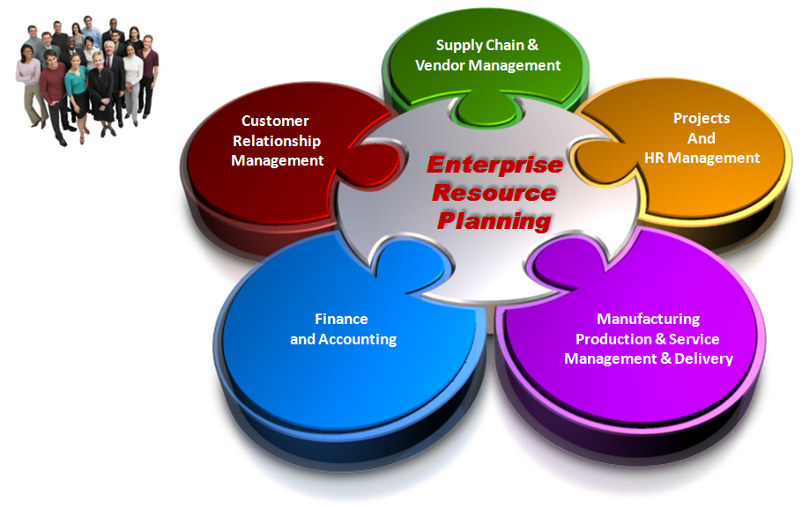
ERP: Integrated Solutions

Slide 39
Audit Testing of GST in Application Software
Configuration
Masters
Transactions
Pre-Implementation Testing
Test
data
Reports
Test
Plan
Map with GST
Pass: Complies with requirements
Test
Results
Issue
Fail – Does not comply
Post-Implementation

Slide 40
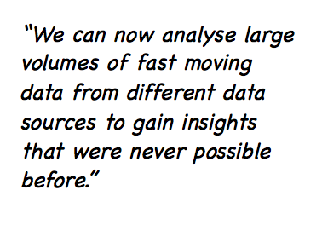
Data Analytics – the New Frontier:
Insightful analysis using Technology

Slide 41

Technology has its own breakdowns: IS Audit

Slide 42
4. Practical Case Study and Scenarios

Slide 43
  ERP
Modify ERP
Vendor Master
Customer Master
Tax Master
Invoice Patterns
Purchase Order master
Modifications in accounting system considering headings for credits, classification of goods / services, RC liability, output tax liability etc. | Modifications considering Time of supply of goods / services. For ex: In case of advance receipts, time of supply would be date of advance receipts when such receipts are before issue of invoice / removal of goods.

Slide 44
1.Master Data Management:
Chart of Accounts
Present Details | GST Impact | Recommendations
Currently, company has following GL masters maintained in ERP for compliance : a. CE b. VAT c. Central Sales Tax d. Service Tax e. Cess if PLA A/c | Need to create new ledgers like CGST, IGST, Cash Ledger, and SGST (separate for each States where company is currently operating or propose to operate.) Ledgers need to be created for both input as well as output duties. | The list of GL accounts to be documented needs to be maintained. Finance team should also decide whether the existing tax GL accounts to be blocked or kept open at the time of migration. As GST is expected to be implemented from 1st July 2017, both sets of tax ledgers have to be maintained.

Slide 45
2. Master Data Management:
Material Masters
Present Details | GST Impact | Recommendations
Currently, inventory is not integrated with the ERP system. Further, there are no service masters maintained in ERP. | Inventory needs to be integrated in the ERP system on the basis of new HSN codes & Service Master need to be configured along with Service Accounting Code. | Company needs to plan to get the HSN codes for all relevant inventory codes In case of services, the master needs to be created for services used by company along with their SAC code.

Slide 46
3. Master Data Management:
Customer/Vendor Masters
Present Details | GST Impact | Recommendations
Currently, following key information is captured: Customer / Vendor Code Customer / Vendor Name Category Address Tax Jurisdiction Payment Terms | Customer/ Vendor Master needs to incorporate their GSTIN No. | The product should be modified to add GSTIN No. in customer or vendor master field. Management should also plan to collect GSTIN number of active customers or vendors. State wise GSTIN of vendors/ customers required where company dealing with multiple offices of same vendor/customer

Slide 47
4. Invoicing: Invoice Format
Present Details | GST Impact | Recommendations
Currently, following information is captured in Sales Invoice: Invoice No. (Numeric) Billed to Shipped to Product Code & Description Packing, Numbers, Shipped Quantity Price Amount Assessable Value CE Sales Tax | Invoice format needs to be changed as per new format. HSN/SAC code wise details to be captured for items. Format of invoice numbering to be changed. Free of cost supply to be converted to discount mechanism which needs to be captured line item wise. | Form in current ERP should be re-designed to cater to GST needs.

Slide 48
5. Taxation: Configuration
Present Details | GST Impact | Recommendations
Currently, different taxes are levied and paid on different basis, like, excise is levied on manufacturing and paid on removal, VAT is levied on sales. Hence, current logic of calculating these taxes is to be configured as per current practices. | Under GST, the taxation will be charged on supply of goods and tax identifier would be place of supply, i.e., Inter State (IGST) and Intra State (CGST + SGST). | Transaction flow has to be mapped in such a manner to comply with the proposed tax implications.

Slide 49
6. Taxation: Configuration
Present Details | GST Impact | Recommendations
Currently, invoices are summarized at gross value and not at line-item level. | Under GST, invoice will be prepared in such a manner that value of goods & tax on that will be calculated & presented HSN/SAC code wise. | This logic needs to be built in ERP to accommodate right set of tax calculations especially if products dealt with are of different HSN code.

Slide 50
7. Business Scenario: Sample Purchase/Sales
Present Details | GST Impact | Recommendations
Currently, samples are sent by factory to warehouse based on stock transfer note charging ED. Subsequently, warehouse generates “sample transfer note” in the name of MR for removal of samples which is further distributed. | Samples should be removed from factory based on GST invoice. Subsequent documentations would depend upon the model to be adopted. | Corresponding changes in transaction processing to be done in existing ERP.

Slide 51
8. Business Scenario:
Goods Supplied Free of Cost
Present Details | GST Impact | Recommendations
Under the Present tax regime, if the goods are supplied free of cost, then tax has to be computed on amount charged from the customers. Specific mention of free supply is made on the invoice. | Advisable to mention the quantity supplied at gross (including FOC), calculate consideration for such gross supply and give discount on line item basis on invoice for quantities supplied as FOC. | Corresponding changes in transaction processing to be done in existing ERP and necessary changes to be made in the invoice format.

Slide 52
9. Business Scenario: Stock Transfer
Present Details | GST Impact | Recommendations
Currently, stock is transferred from factory based on stock transfer note charging appropriate ED. | If stock transfer is inter-State, it must be based on GST invoice. For intra State, stock transfer memo/note could be used. No GST would be charged on such note. | Stock transfer note has to be replaced with the tax invoice in case of inter- state transfer.

Slide 53
10. Business Scenario: Advance
Present Details | GST Impact | Recommendations
Currently, there is no requirement of taxation under Excise or VAT laws, hence there is no impact on taxation on payment of advance to vendors or receiving advances from customers. | Under proposed GST regime, there will a tax implication on payment or receipt of advance from vendor or customer respectively. | Under existing ERP, the process of advance to be reconfigured to include the impact of taxation on advance and its corresponding set off at the time of delivery or receipt of goods or services.

Slide 54
GST Knowledge and Technology skills
Learn
Technology Competencies
Scale
Implement through Software
New Summits
Professional Avenues

Slide 55
What will change with GST and Technology?
Technology
  Digital B to G connect
  End-to-End Technology Driven System
  GST compliance rating
Process
  Transaction Focused
  Transparency from grass-root level of business records
  Triangulation of suppliers and recipient records
  Rectification errors and omissions
  Reconciling returns with books
Discipline
  On-Time submission of returns
  On-Time Payment
  Interest on disputed credits
  Less scope for Kacha Bill
Vat only Dealers to GST
  Compliance to Inherited provisions of Excise and Service Tax in GST

Slide 56

GST Avenues from Technology
Chart your Path

Slide 57

GST challenge: Update Technology skills
Innovate
or
become
irrelevant

Slide 58

Thank You!
For any Clarification, Please Contact
Indirect Taxes Committee of ICAI
Email: idtc@icai.in; Website: www.idtc.icai.org
© Indirect Taxes Committee, ICAI

